Slide 1
College English
Presentation
20223100 심준
Notes:
Hi. This is my College English Final Exam alternative task video. The topic I chose is retro, and I focused on music

Slide 2
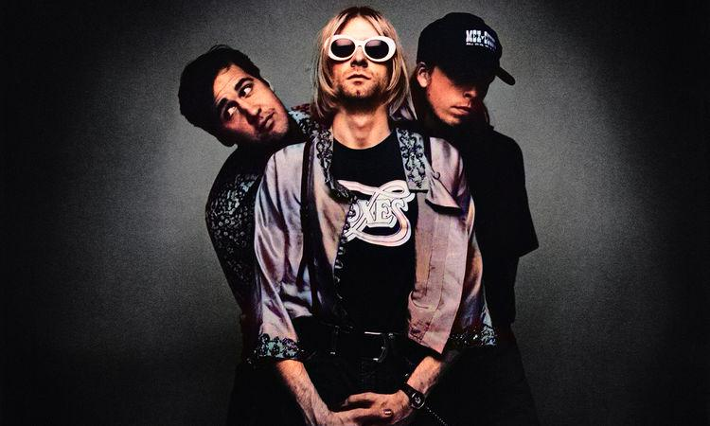
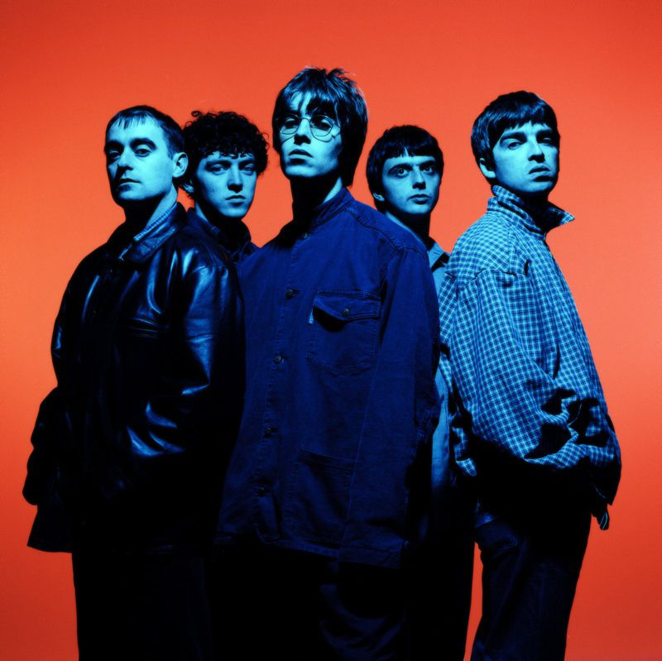
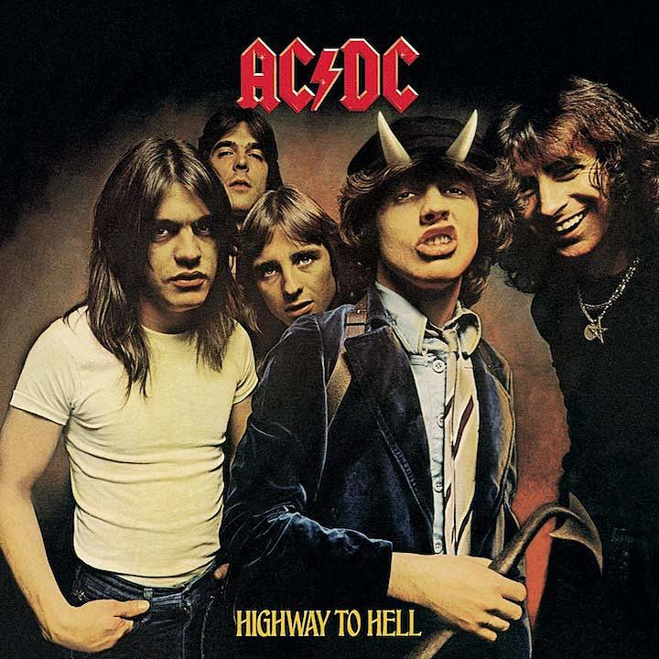
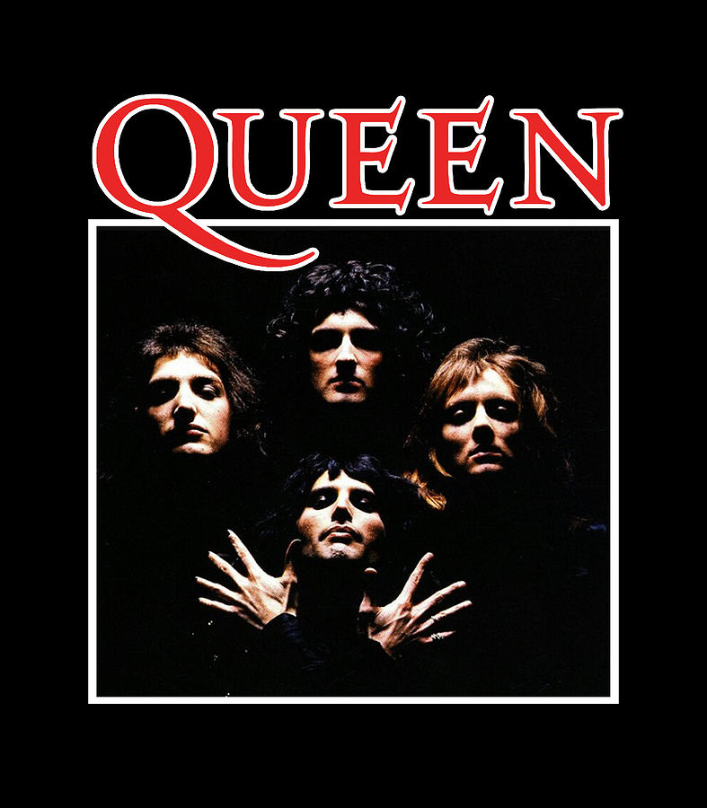
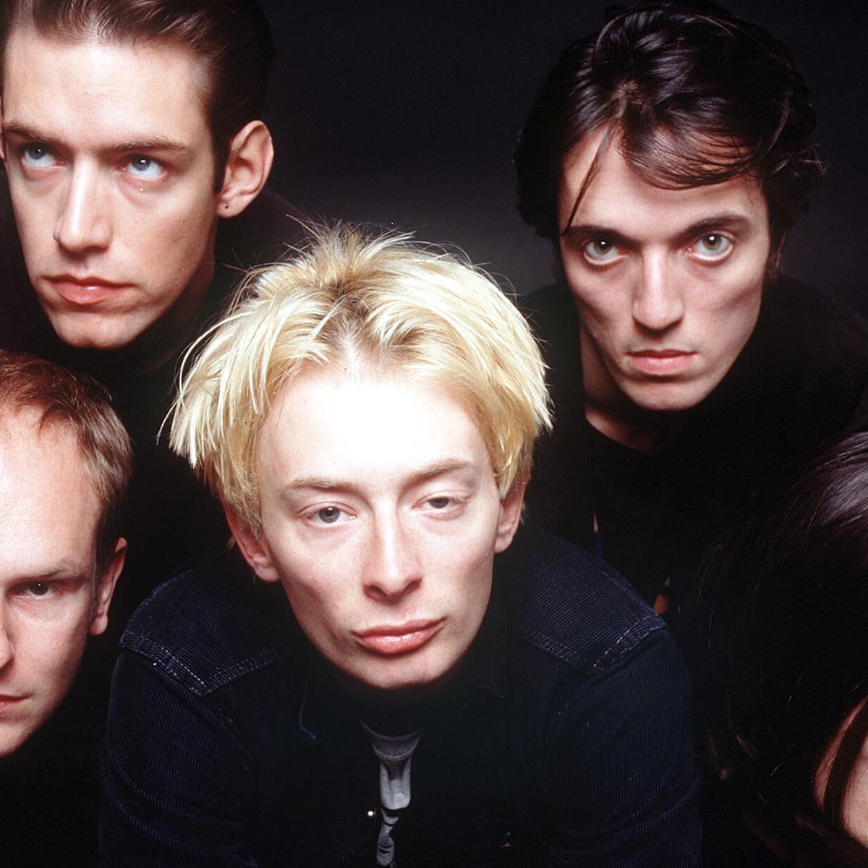
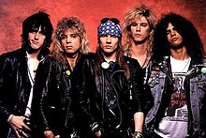
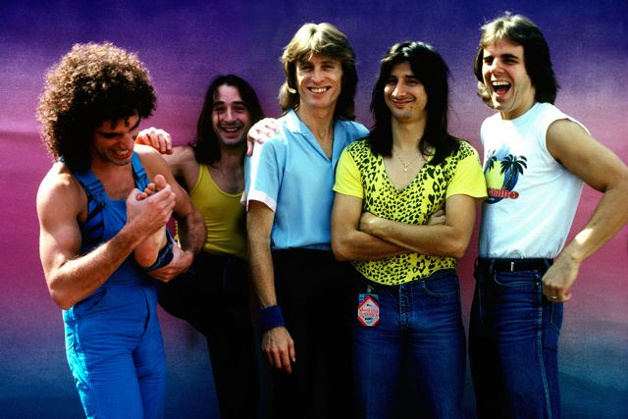
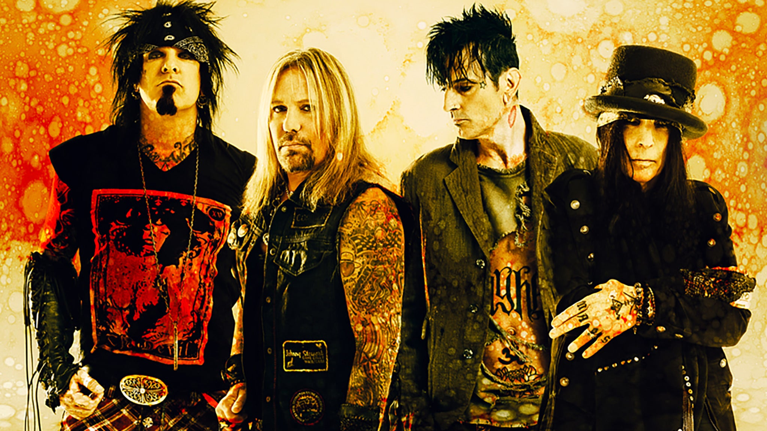
Notes:
These pictures are the singers and bands who sang the music that I like and listen to often. My hobby is collecting CD. This is the first album I bought. Although I couldn't buy the first edition, I'm satisfied because the reason for the complaint is personal satisfaction
Also, I recently started collecting vinyl and bought them. This is MJ’s Bad. Surprisingly, this is the first edition

Slide 3
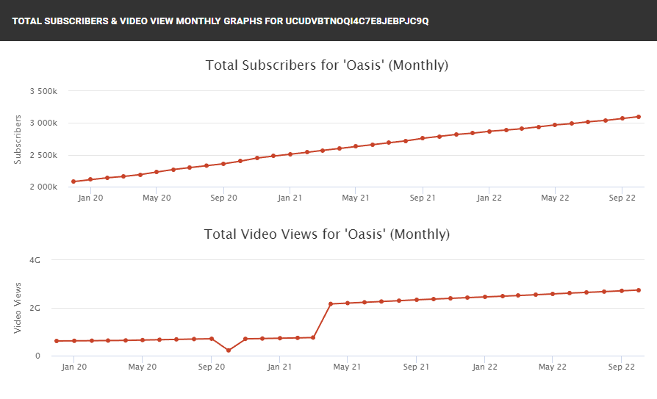
Notes:
Apart from me, people these days love old music quite a lot. This is a graph that shows the subscribers and views of YouTube's Oasis account, both of which are steadily rising.

Slide 4

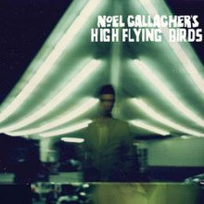
Notes:
In addition, even though Oasis has been disbanded, both brothers have been steadily releasing albums and maintaining their popularity.

Slide 5
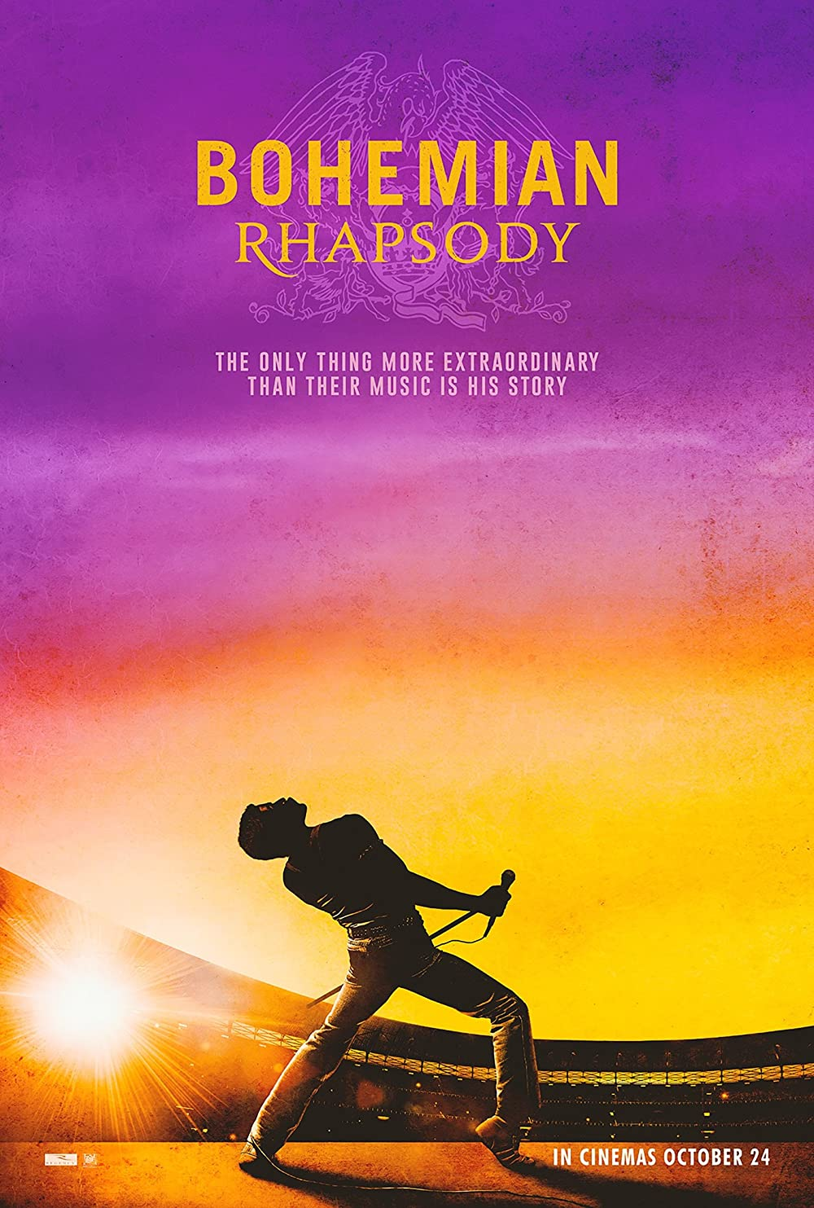
Notes:
In some cases, even though it has been disbanded like an oasis, it remains popular by doing its own music, but there is also a way to create nostalgia through movies like Queen. Bohemian Rhapsody is a biopic of Queen, and not only is it fun to listen to Queen's songs, but it's also fun to check the synchronization of real singers and actors

Slide 6
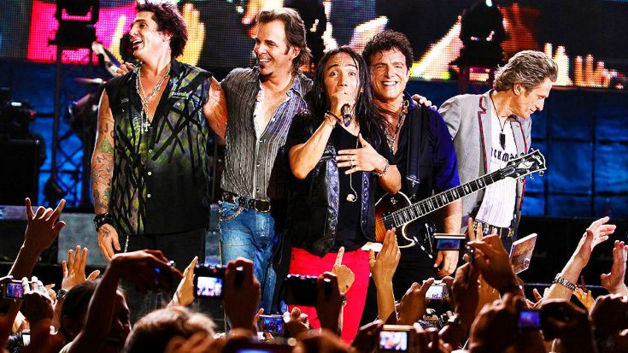
Notes:
In addition, although the existing vocalist has retired, there are cases where he continues his band career by recruiting another vocalist.

